Slide 1
Section 6.3
Properties of the Trigonometric Functions

Slide 2


Slide 3
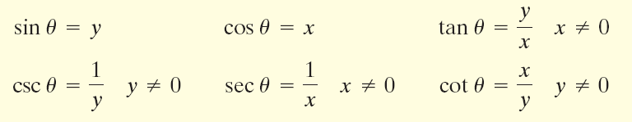

Slide 4

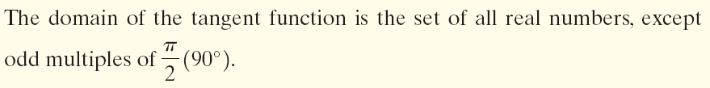
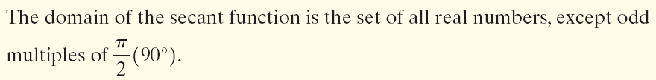

Slide 5



Slide 6
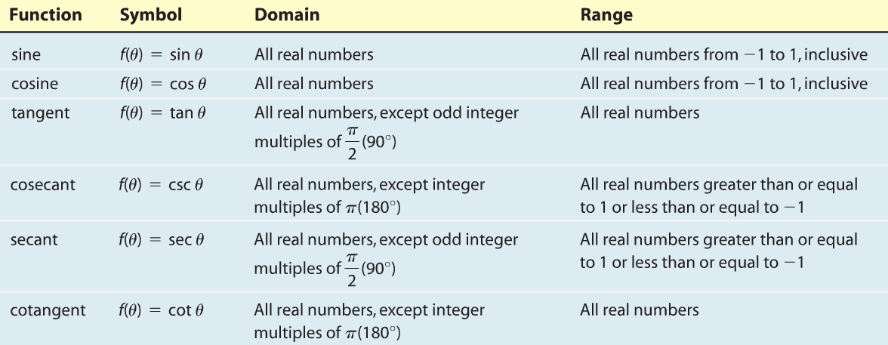

Slide 8
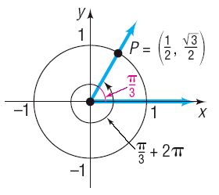

Slide 9

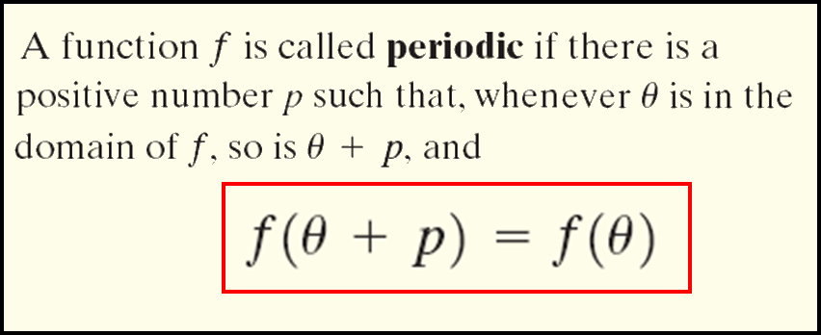
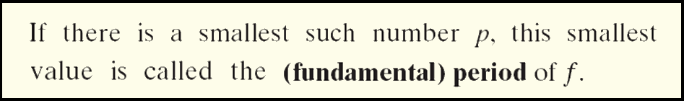

Slide 10


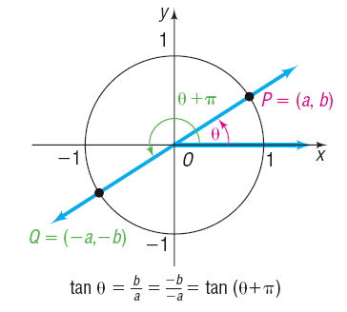

Slide 11

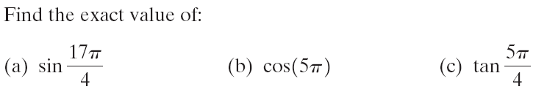
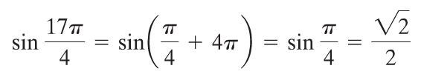


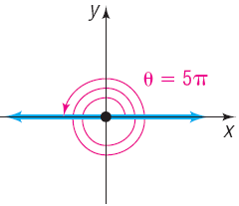

Slide 12


Slide 13
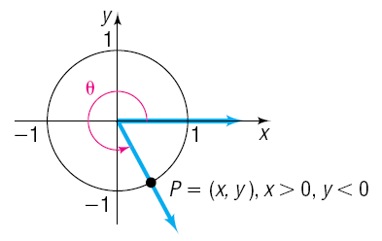
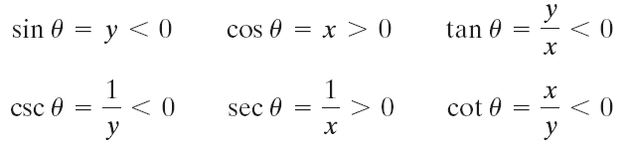

Slide 14
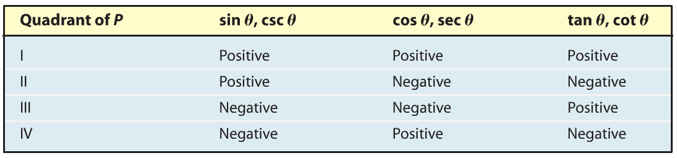
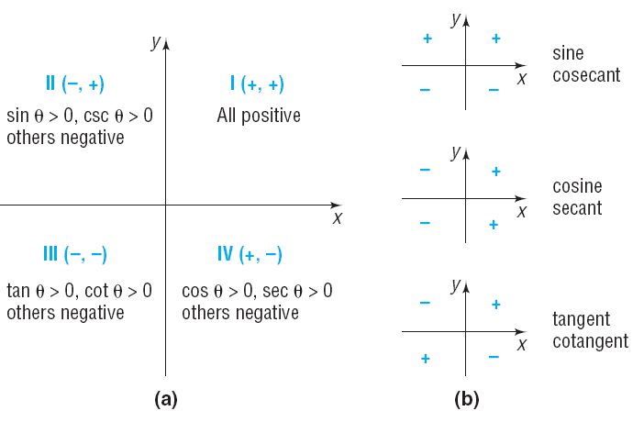

Slide 15
If sin θ > 0 and cos θ < 0, name the quadrant in which the angle θ lies.
For sin θ > 0 the y value must be positive so the angle must be in quadrant I or II.
For cos θ < 0 the x value must be negative so the angle must be in quadrant II or III.
Therefore, this angle must lie in quadrant II.

Slide 16


Slide 17





Slide 18


Slide 19



Slide 20
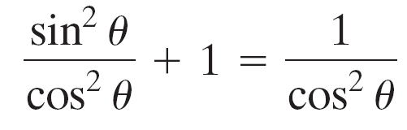



Slide 21

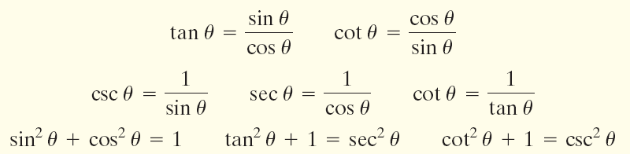

Slide 22





Slide 23


Slide 24

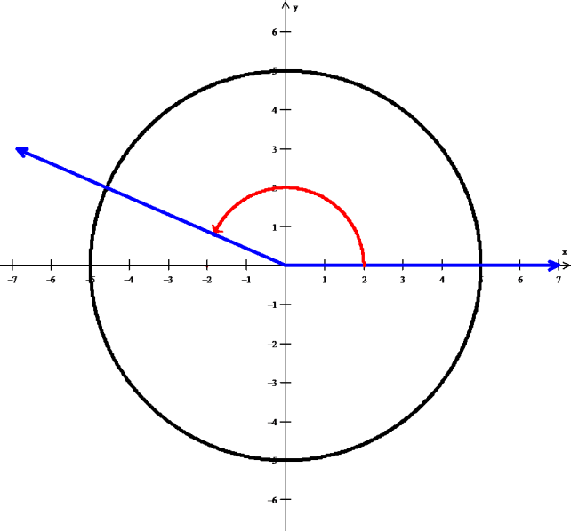
P(x,2)
r = 5
θ

Slide 25

Since θ is in quadrant II, x values are negative

Slide 26
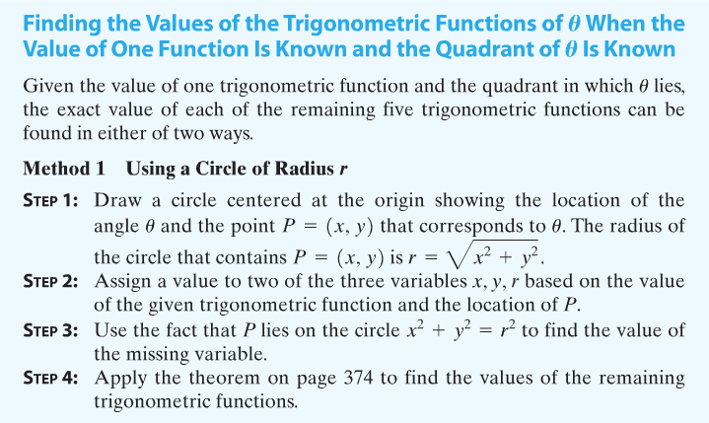


Slide 27

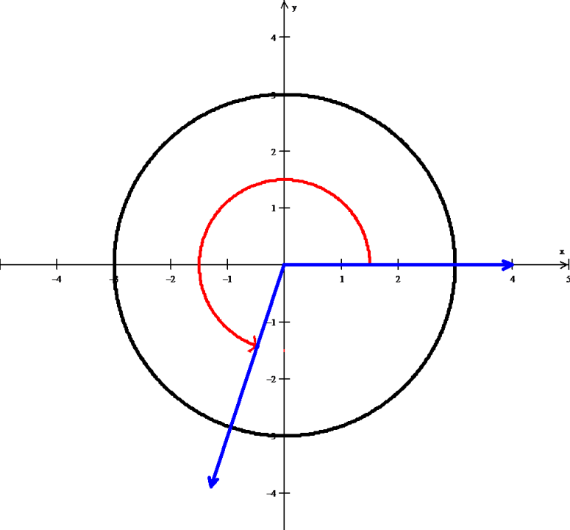
θ
P(-1,-3)

Slide 28
Since sin θ < 0, csc θ is negative.

Slide 29


Slide 30


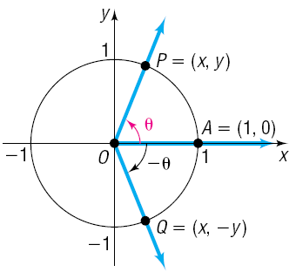

Slide 31
Find the exact value of:
cos (−60°) (b) sin (−390°) (c) tan

